Slide 1
Lecture 3
Python and the NLTK
CSCE 771
Natural Language Processing
Topics
  Python
  NLTK
Readings:
  http://docs.python.org/tutorial/
  http://www.nltk.org/Home
June 9, 2009

Slide 2
Last Time
  Slides from Lecture 1 30-
    Regular expressions in Perl, grep, vi, emacs, word?
    Eliza
  Morphology
  Links
    Text website - http://www.cs.colorado.edu/~martin/slp2.html
    NLTK - http://www.nltk.org/Home
    PYTHON - http://docs.python.org/tutorial/
Today
  Downloading Python
  Downloading nltk
  Python Introduction

Slide 3
Installing Python
Both Python and the NLTK run on both Windows and Linux
The steps I went through in getting Python were:
  Google download python
  Follow link to http://www.python.org/download/
  I selected “Python 2.6.2 (April, 14, 2009)” as the version actually I did the binary only
    Python 2.6.2 Windows installer (Windows binary -- does not include source)
    Actually when I got to nltk I read “NB. Although Python 2.6 and 3.0 are now available, many packages that NLTK requires do not have distributions for Python 2.6 or 3.0. For now you should use NLTK with Python 2.4.* or 2.5.* only.”
    So back to Python 2.5.4
      http://www.python.org/download/releases/2.5.4/
      For x86 processors: python-2.5.4.msi
  Save “python-2.6.2.msi”
  Then as administrator execute python-2.6.2.msi to install

Slide 4
Installing the Natural Language Tool Kit
This is similar to installing python
The steps I went through in getting NLTK were:
Google download NLTK
Follow link to http://www.nltk.org/download
http://www.nltk.org/download
Save “nltk-0.9.9.win32-py2.5.msi”
Then as administrator execute nltk-0.9.9.win32-py2.5.msi

Slide 5
Python Introduction
After Python is installed if you are using windows I suggest you use the IDLE GUI.
Execute IDLE – the graphical user interface to Python
Save the file PythonTutorial.py (emailed to you)

Slide 6
IDLE – the graphical user interface to Python
Python 2.5.4 (r254:67916, Dec 23 2008, 15:10:54) [MSC v.1310 32 bit (Intel)] on win32
Type "copyright", "credits" or "license()" for more information.
****************************************************************
Personal firewall software may warn about the connection IDLE
makes to its subprocess using this computer's internal loopback
interface. This connection is not visible on any external
interface and no data is sent to or received from the Internet.
****************************************************************
IDLE 1.2.4
>>> (From the FILE menu select Open and open PythonTutorial.py)

Slide 7
http://docs.python.org/tutorial/introduction.html
When this is loaded you can “run the module” from the run menu.
Note there are several think that would cause errors and these have been commented out with a preceding ###ERROR ###
Cut-n-paste the individual lines in to verify the execution shown on the next collection of slides

Slide 8
Most of these programs are from the python Tutorial
  http://docs.python.org/tutorial/introduction.html (section 3)
  You might find it easier to read through the examples there and try out a selective few.
Except
  Open a file and process each word on slide 38
  Also, Grab a document from the web - from the Python Cookbook on slide 42
  I was planning to do Voice over but its late and I have to write a letter of recommendation and get the next lecture ready.

Slide 9
python0.py - hello world
>>> print "hello world\n!"
hello world
!
>>> print 'hello world!\n'
hello world!
>>>

Slide 10
pt_comment0.py - Python Tutorial example simple comments
>>> SPAM = 1 # and this is the second comment
>>> # ... and now a third!
>>> STRING = "# This is not a comment."
>>> STRING
'# This is not a comment.'
>>>

Slide 11
pt_calculator0.py - Python Tutorial example as a simple calculator
>>> 2+2
4
>>> (50-5*6)/4
5
>>> 7/-3
-3
>>>

Slide 12
pt_variables0.py - Python Tutorial example simple variables
>>> width = 20
>>> height = 5*9
>>> width * height
900
>>> x = y = z = 0 # Zero x, y and z
>>> x
0
>>> y
0
>>> z
0
>>>

Slide 13
pt_variables1.py - Python Tutorial example undefined variables
>>> n
Traceback (most recent call last):
File "<pyshell#24>", line 1, in <module>
n
NameError: name 'n' is not defined
>>>

Slide 14
pt_float0.py - Python Tutorial example floats
>>> 3 * 3.75 / 1.5
7.5
>>> 7.0 / 2
3.5
>>>

Slide 15
# pt_complex0.py - Python Tutorial example complex numbers
>>> 1j * 1J
(-1+0j)
>>> 1j * complex(0,1)
(-1+0j)
>>> 3+1j*3
(3+3j)
>>> (3+1j)*3
(9+3j)
>>> (1+2j)/(1+1j)
(1.5+0.5j)
>>>

Slide 16
# pt_complex1.py - Python Tutorial example complex numbers extracting components
>>> a=1.5+0.5j
>>> a.real
1.5
>>> a.imag
0.5
>>>

Slide 17
# pt_strings0.py - Python Tutorial example: strings
>>> 'spam eggs'
'spam eggs'
>>> 'doesn\'t'
"doesn't"
>>> "doesn't"
"doesn't"
>>> '"Yes," he said.'
'"Yes," he said.'
>>> "\"Yes,\" he said."
'"Yes," he said.'
>>> '"Isn\'t," she said.'
'"Isn\'t," she said.'
>>>

Slide 18
# pt_strings2.py - Python Tutorial example: concatenating strings
>>> word = 'Help' + 'A'
>>> word
'HelpA'
>>> '<' + word*5 + '>'
'<HelpAHelpAHelpAHelpAHelpA>'
>>>

Slide 19
pt_strings3.py - Python Tutorial example: concatenating strings
>>> 'str' 'ing'
'string'
>>> 'str'.strip() + 'ing'
'string'
>>> 'str'.strip() 'ing' # <- This is invalid
SyntaxError: invalid syntax
>>>

Slide 20
pt_strings4.py - Python Tutorial example: substring selection
>>> word[4]
'A'
>>> word[0:2] # the slice containing word[0] word[1] word[2]
'He'
>>> word[2:4] # this slice notation is borrowed from the language Icon
'lp'
>>>

Slide 21
pt_strings6.py - Python Tutorial example: strings can't be changed
>>> word[0] = 'x'
Traceback (most recent call last):
File "<pyshell#54>", line 1, in <module>
word[0] = 'x'
TypeError: 'str' object does not support item assignment
>>> word[:1] = 'Splat'
Traceback (most recent call last):
File "<pyshell#55>", line 1, in <module>
word[:1] = 'Splat'
TypeError: 'str' object does not support item assignment
>>>

Slide 22
pt_strings7.py - Python Tutorial example: creating new strings
>>> 'x' + word[1:]
'xelpA'
>>> 'Splat' + word[4]
'SplatA'
>>>

Slide 23
pt_strings8.py - Python Tutorial example: creating new strings II
>>> word[:2] + word[2:]
'HelpA'
>>> word[:3] + word[3:]
'HelpA'
>>>

Slide 24
pt_strings9.py - Python Tutorial example: creating new strings III
>>> word[1:100]
'elpA'
>>> word[10:]
''
>>> word[2:1]
''
>>>

Slide 25
pt_strings10.py - Python Tutorial example: negative indices
>>> word
'HelpA'
>>> word[-1] # The last character
'A'
>>> word[-2] # The last-but-one character
'p'
>>> word[-2:] # The last two characters
'pA'
>>> word[:-2] # Everything except the last two characters
'Hel'
>>> word[-0] # (since -0 equals 0)
'H'

Slide 26
pt_strings11.py - Python Tutorial example: out of range negative indices
>>> word
'HelpA'
>>> word[-100:]
'HelpA‘
>>> word[-10] # error
Traceback (most recent call last):
File "<pyshell#74>", line 1, in <module>
word[-10] # error
IndexError: string index out of range
>>>

Slide 27
pt_strings12.py - Python Tutorial example: the length function
>>> s = 'supercalifragilisticexpialidocious'
>>> len(s)
34
>>>

Slide 28
pt_lists0.py - Python Tutorial lists examples: simple
>>> a = ['spam', 'eggs', 100, 1234]
>>> a
['spam', 'eggs', 100, 1234]
>>>

Slide 29
pt_lists1.py - Python Tutorial lists examples: lists can be sliced, concatenated and so on
>>> a
['spam', 'eggs', 100, 1234]
>>> a[0]
'spam'
>>> a[3]
1234
>>> a[-2]
100
>>> a[1:-1]
['eggs', 100]
>>> a[:2] + ['bacon', 2*2]
['spam', 'eggs', 'bacon', 4]
>>> 3*a[:3] + ['Boo!']
['spam', 'eggs', 100, 'spam', 'eggs', 100, 'spam', 'eggs', 100, 'Boo!']
>>>

Slide 30
pt_lists2.py - Python Tutorial lists examples: changing elements of a list
>>> a = ['spam', 'eggs', 100, 1234]
>>> a
['spam', 'eggs', 100, 1234]
>>> a[2] = a[2] + 23
>>> a
['spam', 'eggs', 123, 1234]
>>>

Slide 31
pt_lists3.py - Python Tutorial lists examples: Assignment to slices
>>> # Replace some items:
>>> a
['spam', 'eggs', 123, 1234]
>>> a[0:2]=[1,2]
>>> a
[1, 2, 123, 1234]
>>>

Slide 32
# Remove some:
>>> a = ['spam', 'eggs', 100, 1234]
>>> a[0:2] = []
>>> a
[100, 1234]
>>>

Slide 33
>>> a = ['spam', 'eggs', 100, 1234]
>>> a[1:1] = ['bletch', 'xyz']
>>> a
['spam', 'bletch', 'xyz', 'eggs', 100, 1234]
>>>

Slide 34
>>> a = ['spam', 'eggs', 100, 1234]
>>> a
['spam', 'eggs', 100, 1234]
>>> a[:0] = a
>>> a
['spam', 'eggs', 100, 1234, 'spam', 'eggs', 100, 1234]
>>> >>> a[:] = [ ]
>>> a
[ ]
>>>

Slide 35
pt_lists4.py - Python Tutorial lists examples: length applied to lists
>>> a = ['a', 'b', 'c', 'd']
>>> len(a)
4
>>> q = [2, 3]
>>> p = [1, q, 4]
>>> len(p)
3
>>> p
[1, [2, 3], 4]
>>>

Slide 36
>>> p
[1, [2, 3], 4]
>>> p[1]
[2, 3]
>>> p[1][0]
2
>>> p[1].append('xtra')
>>> p
[1, [2, 3, 'xtra'], 4]
>>>

Slide 37
pt_program1.py - Python Tutorial : Fibonacci series:
a, b = 0,1
while b < 10:
print b
a, b = b, a+b
1
1
2
3
5
8
>>>

Slide 38
#http://mail.python.org/pipermail/python-list/2005-March/311642.html
import re
f=open('file.py', 'r')
for line in f:
for word in line.split(' '):
print word.strip()

Slide 39
Output in two columns
#http://mail.python.org/pipermail/python-list/2005-March/311642.html
import
re
f=open('file.py',
'r')
for
line
in
f:
for
word
in
line.split('
'):
print
word.strip()
>>>

Slide 40
http://wiki.python.org/moin/WebClientProgramming
Libraries
utidylib and mxTidy -- Python interfaces to html tidy library to clean up HTML documents.
html5lib A HTML5-compliant library for parsing arbitarily-broken HTML to a range of tree formats including minidom, elementtree (including lxml) and BeautifulSoup
BeautifulSoup -- a permissive HTML parser.
Don't use HTMLParser on HTML that might be invalid! That way lies pain. Either clean it up (using tidy), or use a different parser.

Slide 41
urllib, urllib2, and httplib in the standard library.
ClientCookie, ClientForm, and Mechanize are higher-level libraries for writing a web client.
mechanoid a mechanize fork.
libxml2dom can parse HTML by employing libxml2's liberal HTML parser.
Resources
Grab a document from the web - from the Python Cookbook
Python web-client programming general FAQs.
urllib -- Open arbitrary resources by URL
urllib2 -- extensible library for opening URLs

Slide 42
pt_lists3.py - Python Tutorial lists examples: Assignment to slices
>>> # Replace some items:
>>> a
['spam', 'eggs', 123, 1234]
>>> a[0:2]=[1,2]
>>> a
[1, 2, 123, 1234]
>>>

Slide 43
pt_program1.py - Python Tutorial : Fibonacci series:
a, b = 0,1
while b < 10:
print b
a, b = b, a+b
1
1
2
3
5
8
>>>

Slide 44
#http://mail.python.org/pipermail/python-list/2005-March/311642.html
import re
f=open('file.py', 'r')
for line in f:
for word in line.split(' '):
print word.strip()

Slide 45
Grab a document from the web
from urllib import urlopen
doc = urlopen("http://www.python.org").read()
print doc

Slide 46
Combining the read Webpage and read words
from urllib import urlopen
doc = urlopen("http://www.python.org")
for line in f:
for word in line.split(' '):
print word.strip()

Slide 47
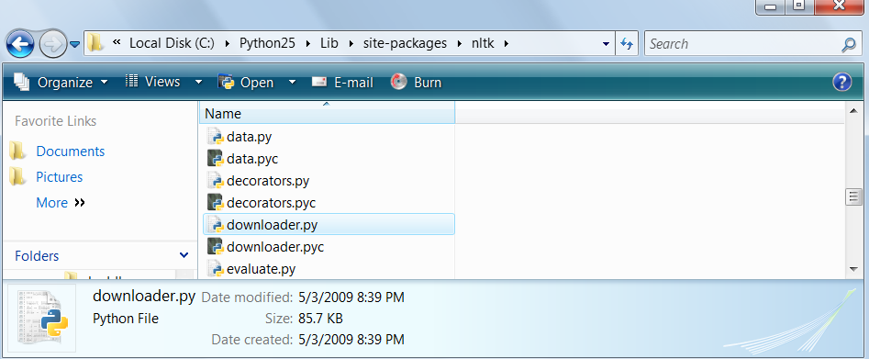
Installing the NLTK pictures
The result of installing nltk is not as apparent as installing python. Nltk is just a program/library you run under python.
So find the downloader.py python program
Brown Corpus Tags Part 2

Slide 48
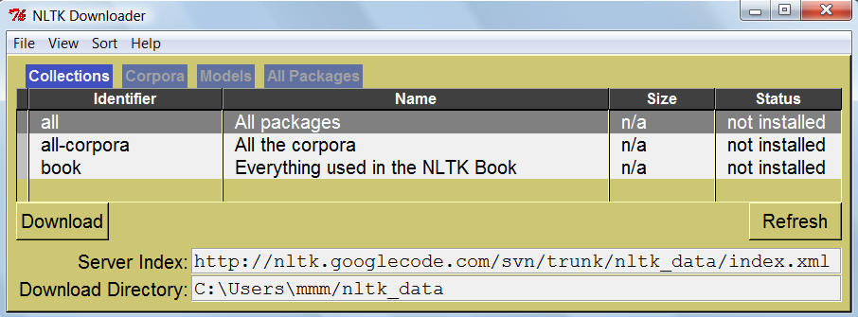
Downloading
Downloading either
Double click on downloader.py or
>>> import nltk
>>> nltk.download()

Slide 49
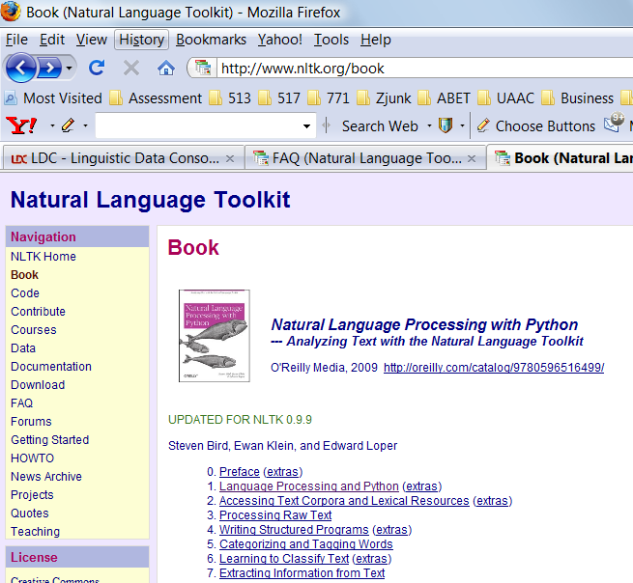
NLTK Book
http://www.nltk.org/book

